Slide 1

CSRF VULNERABILITY

Slide 2
Abdul Kalam Technical University
INTERNSHIP 2020
NAME:- Mridul Singh
SUBMITTED TO :- DataRitz Technologies
ROLL NO. :- 1803213101
Under the guidance of
KRISHNA VIR SINGH

Slide 3
COURSE DESCRIPTION
CISCO Certified Cyber Ops Associate
Cisco's CCNA Cyber Ops certification provides individuals with the knowledge to identify and respond to security incidents. This certification provides a path to working in a Security Operations Center (SOC) and security positions. As a CCNA level certification, Cyber Ops provides introductory knowledge so one may be aware of the security landscape, understand security concepts and general networking. We learn topics such as networking concepts and IP addressing, as well as security concepts including access control models, risk assessment, and the CIA triad. We will also review cryptography methods and host-based analysis details, as well as security monitoring tools, and attack methods used by threat actors.

Slide 4
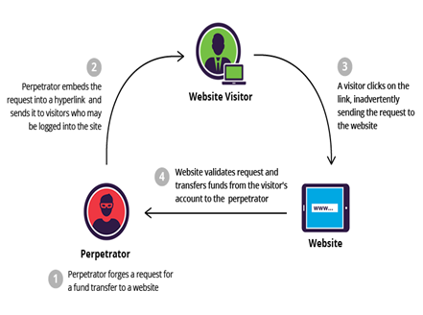
WHAT IS CSRF ?
Cross-site request forgery (also known as CSRF) is a web security vulnerability that allows an attacker to induce users to perform actions that they do not intend to perform. It allows an attacker to partly circumvent the same origin policy, which is designed to prevent different websites from interfering with each other.

Slide 5
What is the impact of a CSRF attack?
In a successful CSRF attack, the attacker causes the victim user to carry out an action unintentionally. For example, this might be to change the email address on their account, to change their password, or to make a funds transfer. Depending on the nature of the action, the attacker might be able to gain full control over the user's account. If the compromised user has a privileged role within the application, then the attacker might be able to take full control of all the application's data and functionality.

Slide 6
How does CSRF work?
For a CSRF attack to be possible,
A relevant action. There is an action within the application that the attacker has a reason to induce. This might be a privileged action (such as modifying permissions for other users) or any action on user-specific data (such as changing the user's own password).
Cookie-based session handling. Performing the action involves issuing one or more HTTP requests, and the application relies solely on session cookies to identify the user who has made the requests. There is no other mechanism in place for tracking sessions or validating user requests.

Slide 7

TOOL DESCRIPTION:-
Burp Suite is an integrated platform for performing security testing of web applications. It is designed to be used by hands-on testers to support the testing process. With a little bit of effort, anyone can start using the core features of Burp to test the security of their applications.

Slide 8
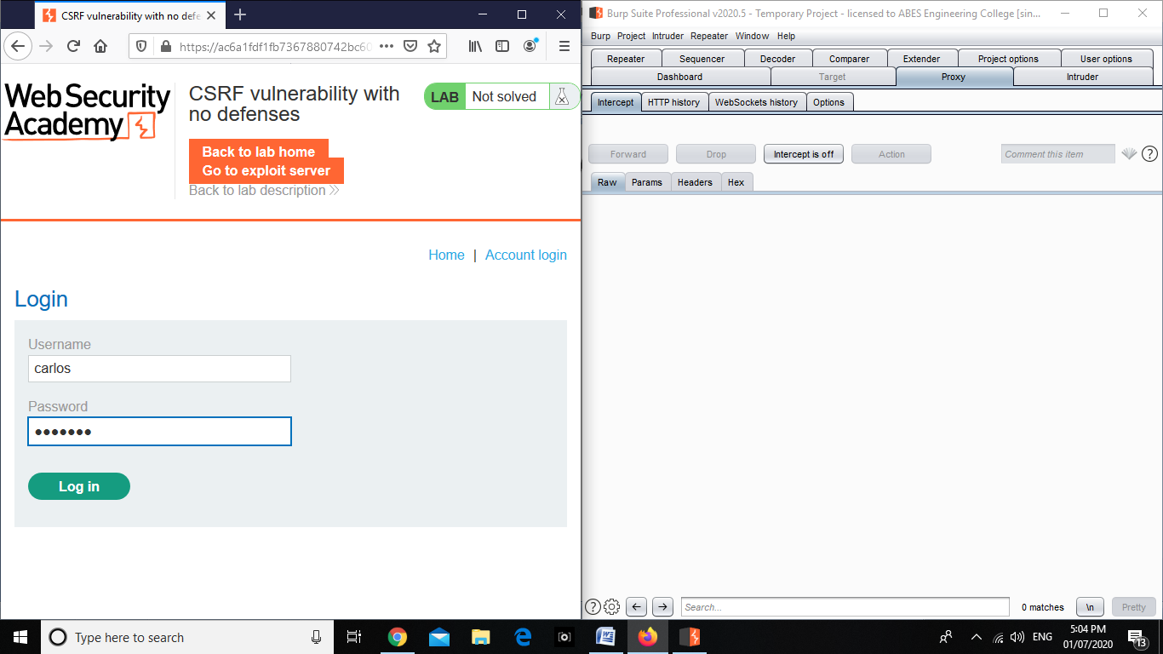
Exploitation

Slide 9
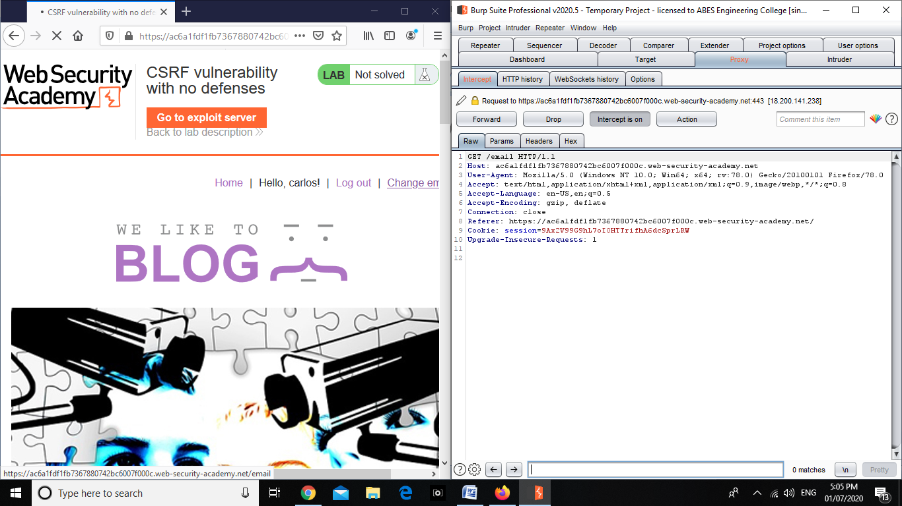
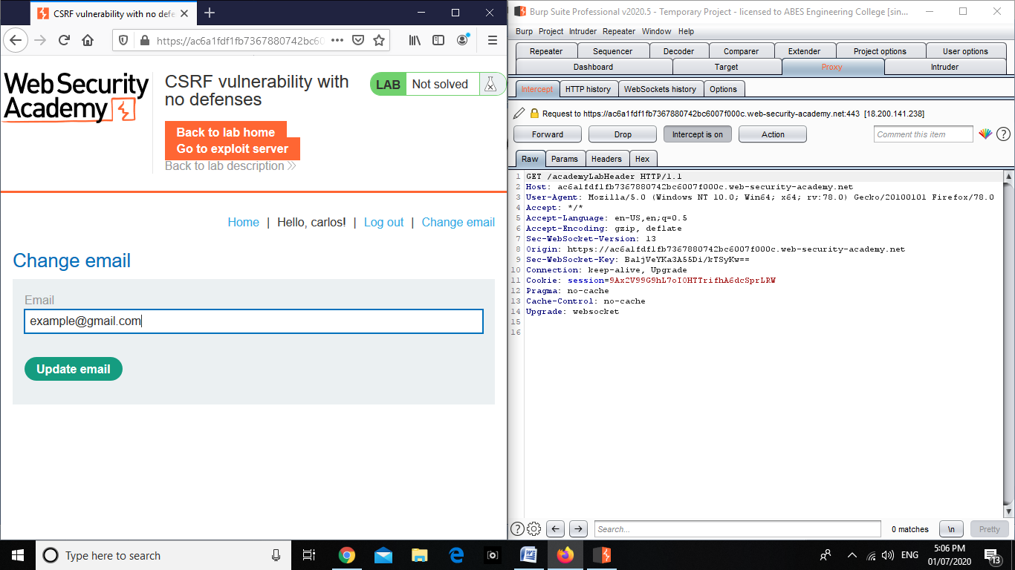

Slide 10
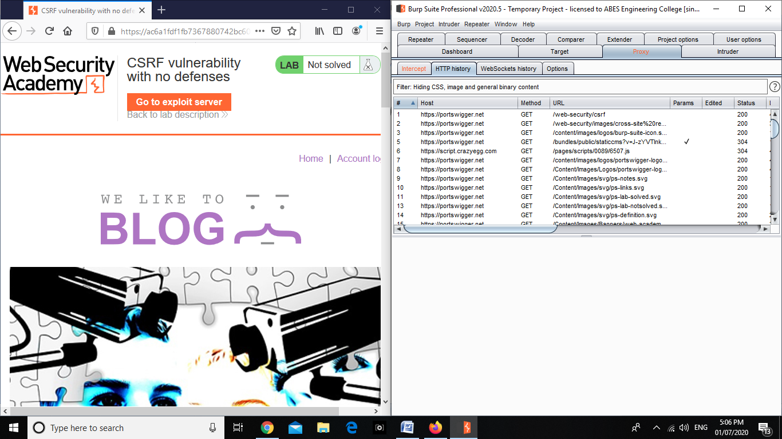
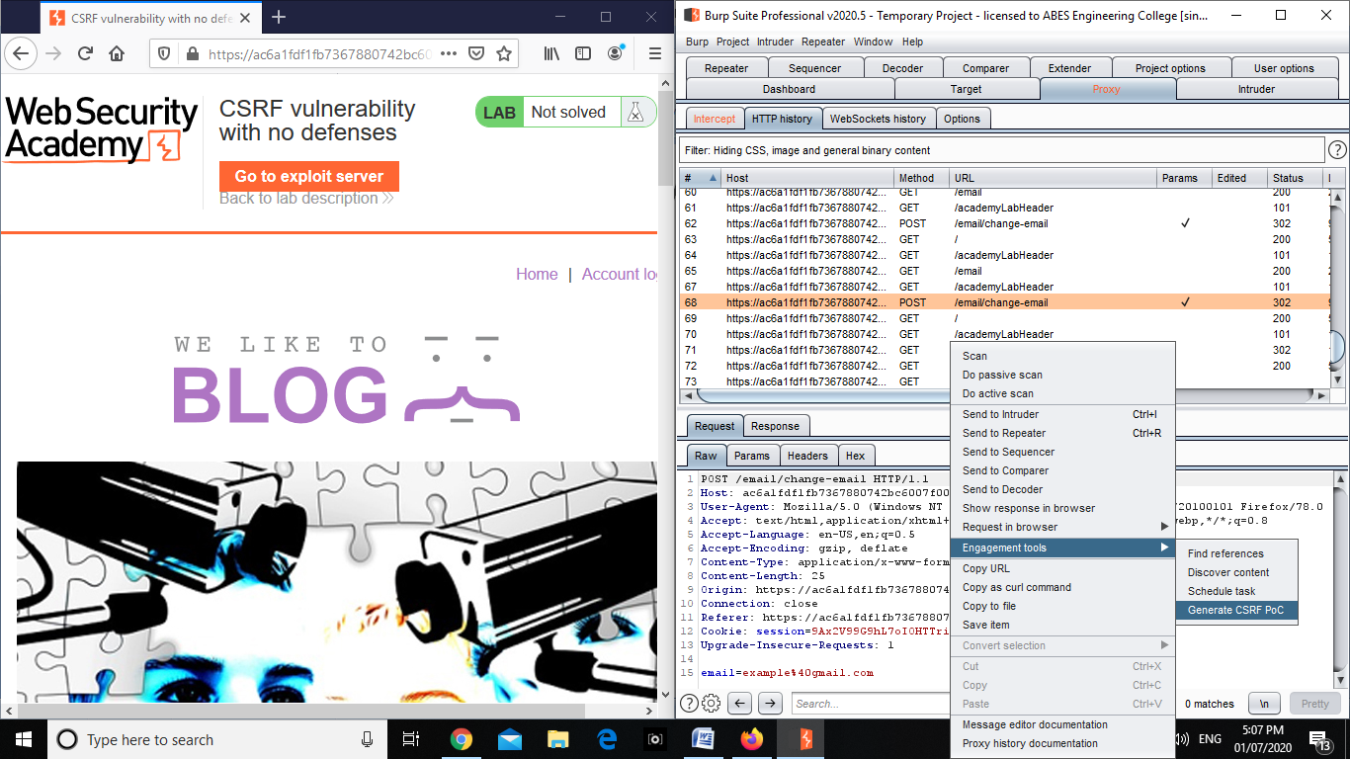

Slide 11
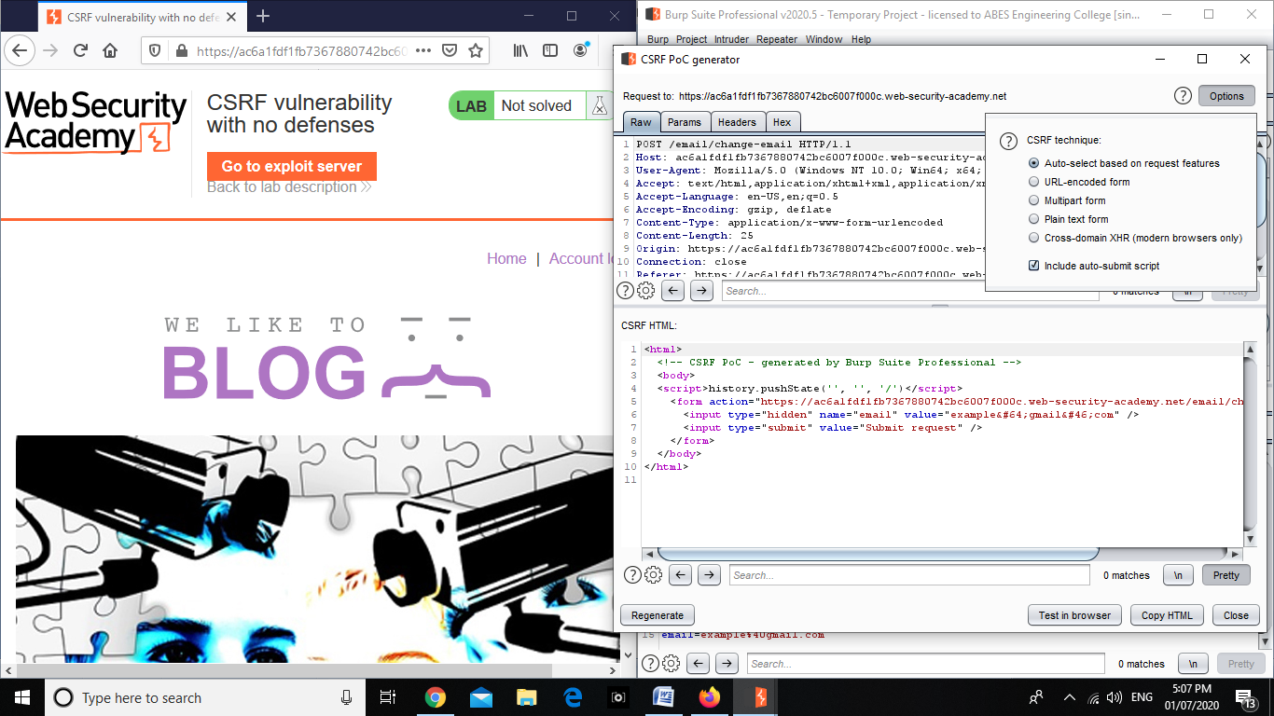
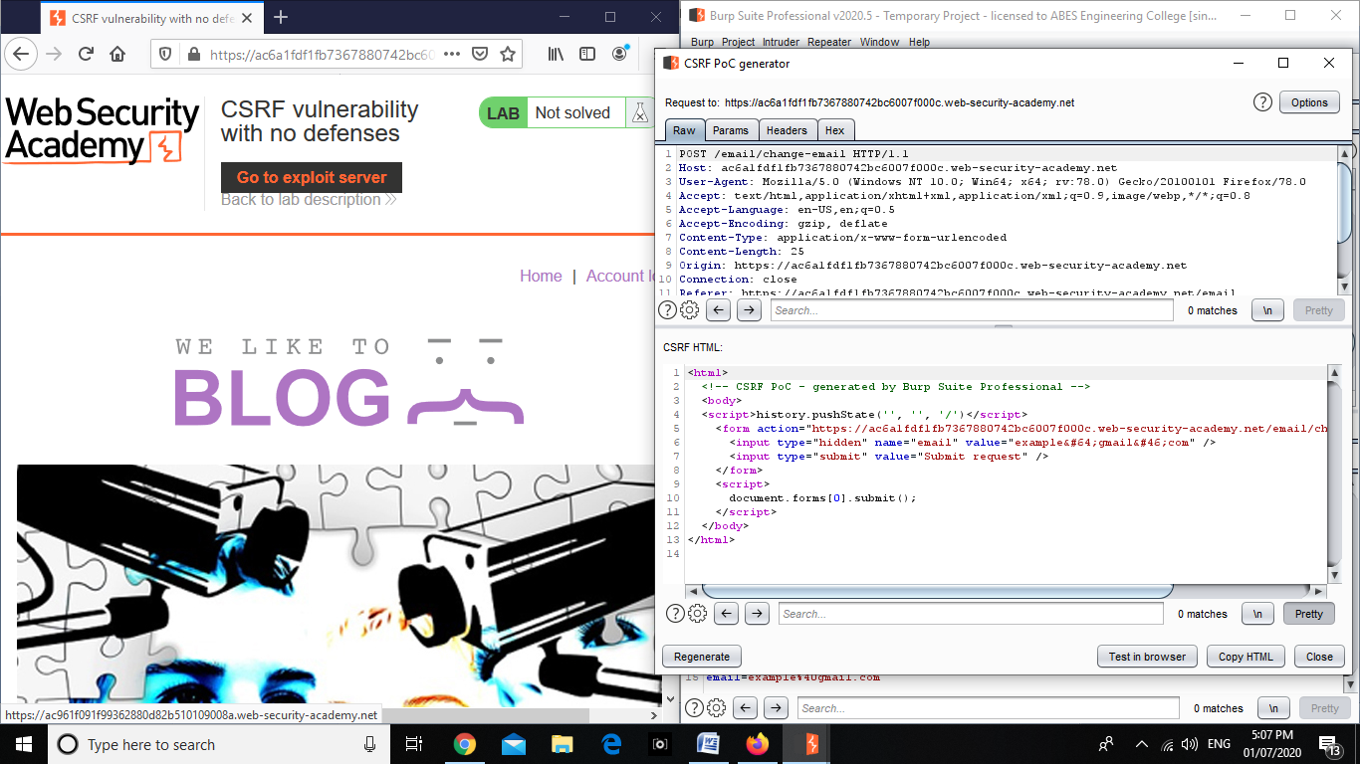

Slide 12
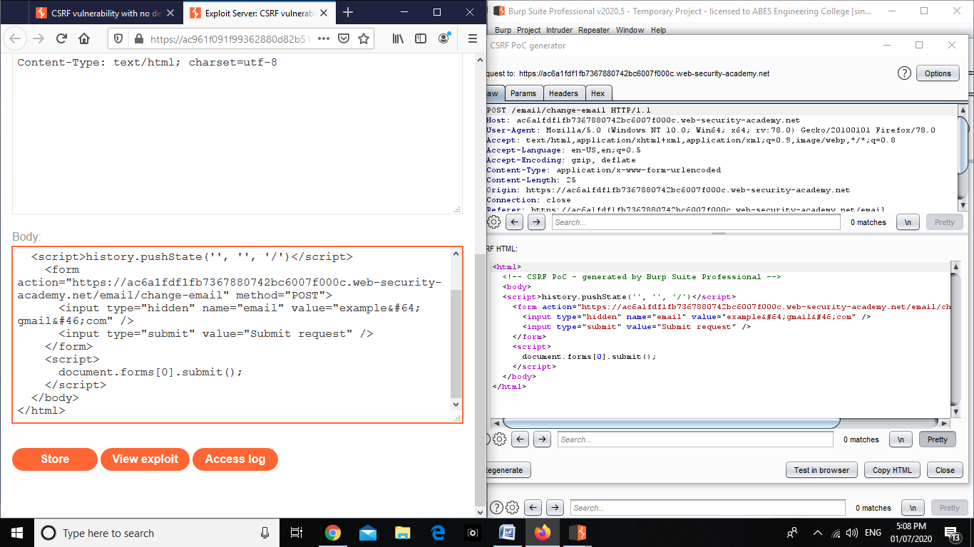

Slide 13


